Slide 1
Interrupt structure | Vector interrupt table, Interrupt service routines – Edge triggered, Timer Periodic Interrupts, NVIC, | To understand the Interrupt structure in ARM Cortex M4 based MCU

Slide 2
Why GPIO Interrupts ?
we have seen an example to control an onboard LED of STM32 using onboard switches such as SW1 and SW2.
In that case, the microcontroller keeps checking the status of the push button by polling PA6 and PB10 bits of PORTA and PORTB of STM32 microcontroller.
But one of the main drawbacks of the polling method is that microcontroller will have to check the status of input switches on every sequential execution of the code or keep monitoring continuously (Polling method).
Therefore, external or GPIO interrupts are used to synchronize external physical devices with microcontrollers.
Hence, instead of checking the status of input switches continuously, a GPIO pin which is configured as digital input, can be initialized to produce an interrupt whenever the state of the switch changes.
A source of interrupt trigger can be on falling edges, rising edges or both falling and rising edges.
In summary, use of external GPIO interrupts makes embedded system event driven, responsive and they make use of microcontroller’s processing time and resources efficiently.

Slide 3
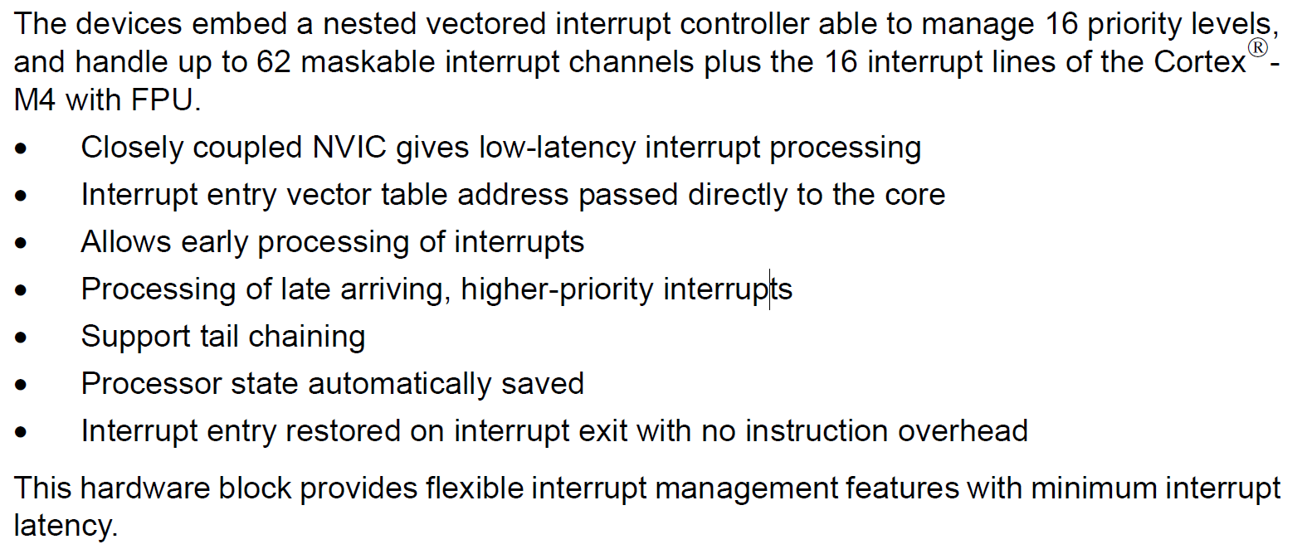
Nested Vectored Interrupt Controller (NVIC)

Slide 4
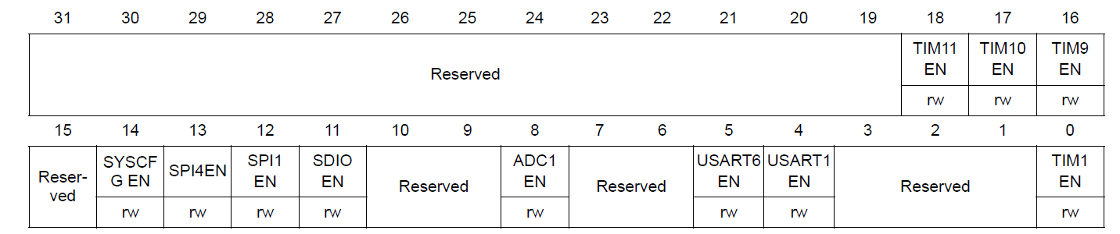
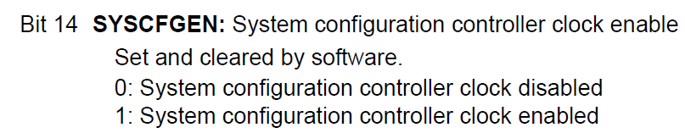
RCC APB2 peripheral clock enable register (RCC_APB2ENR)
Enable IRQ Clock

Slide 5
Enable External Interrupt Configuration Register

Slide 6
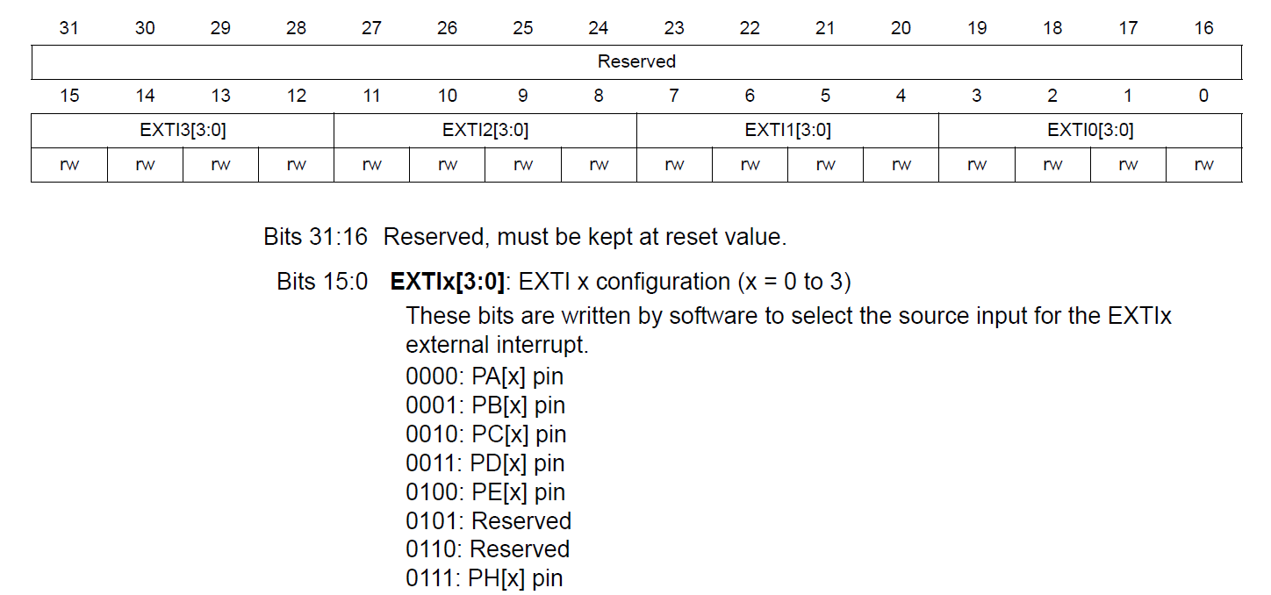
SYSCFG external interrupt configuration register 1 (SYSCFG_EXTICR1)

Slide 7
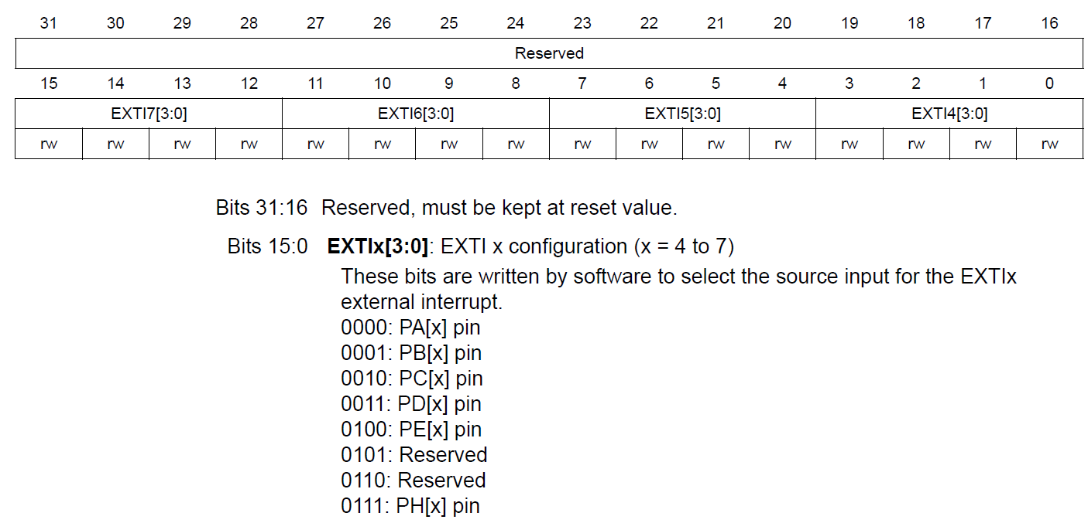
SYSCFG external interrupt configuration register 2 (SYSCFG_EXTICR2)

Slide 8
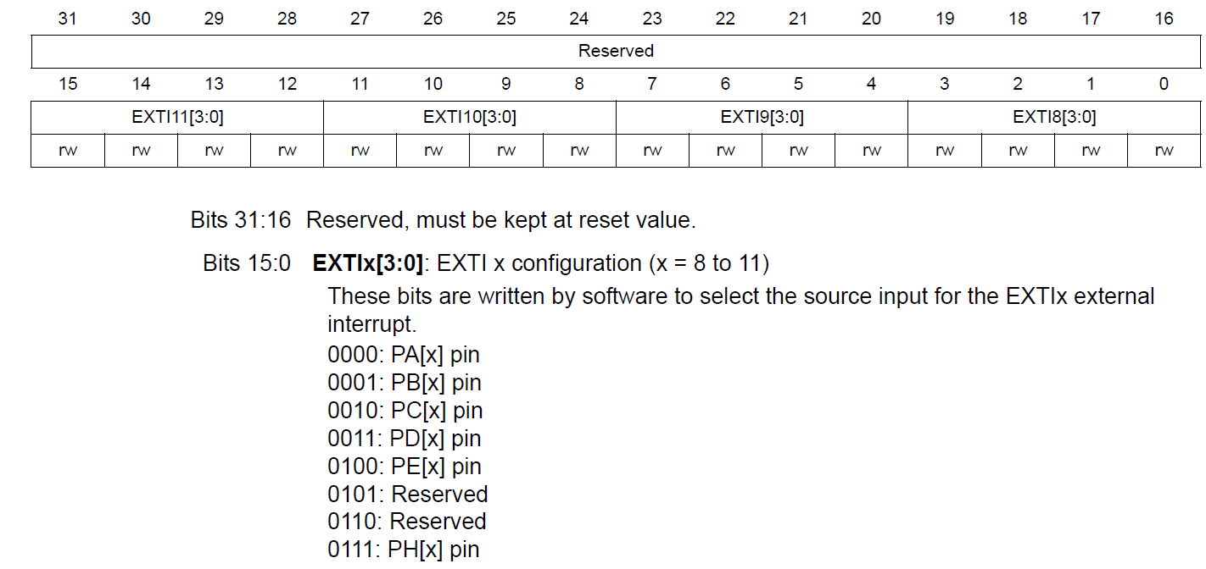
SYSCFG external interrupt configuration register 3 (SYSCFG_EXTICR3)

Slide 9
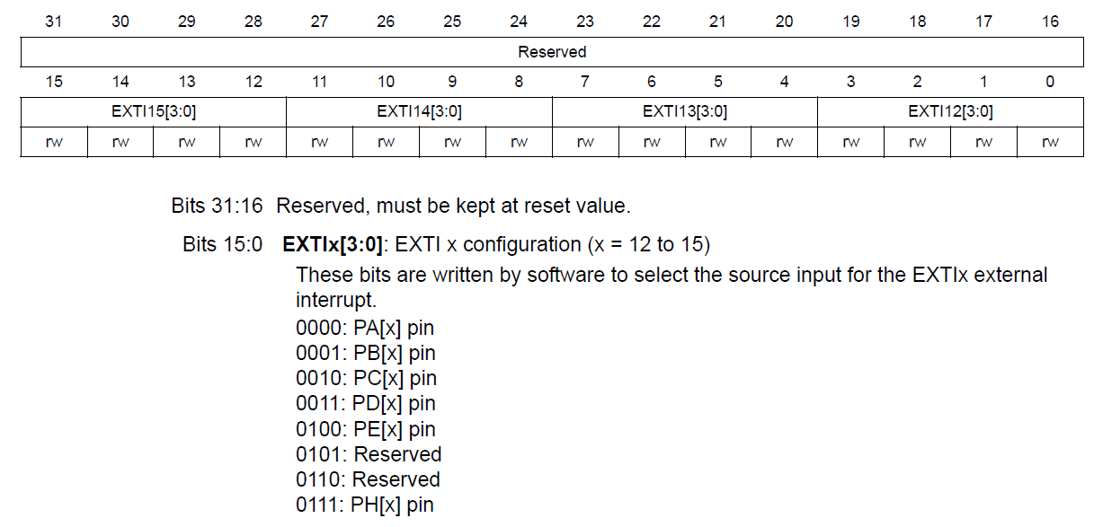
SYSCFG external interrupt configuration register 4 (SYSCFG_EXTICR4)

Slide 10
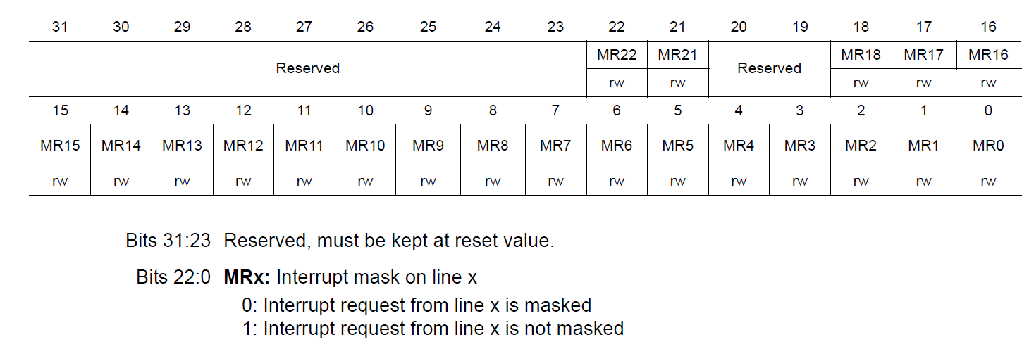
Enable The Interrupt Mask register
Interrupt mask register (EXTI_IMR)

Slide 11
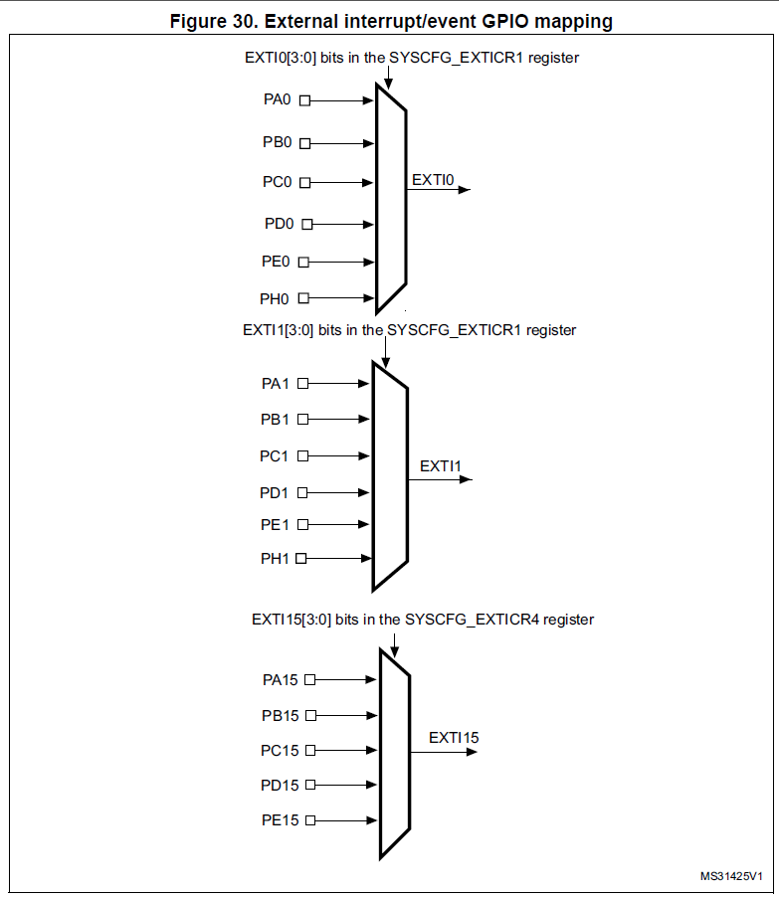
External interrupt/event GPIO mapping

Slide 12
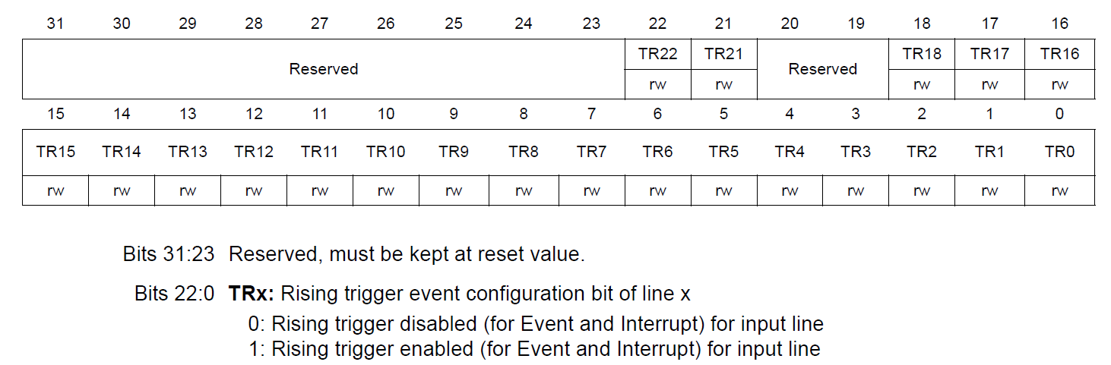
Select The Interrupt Trigger (1)
Rising trigger selection register (EXTI_RTSR)

Slide 13
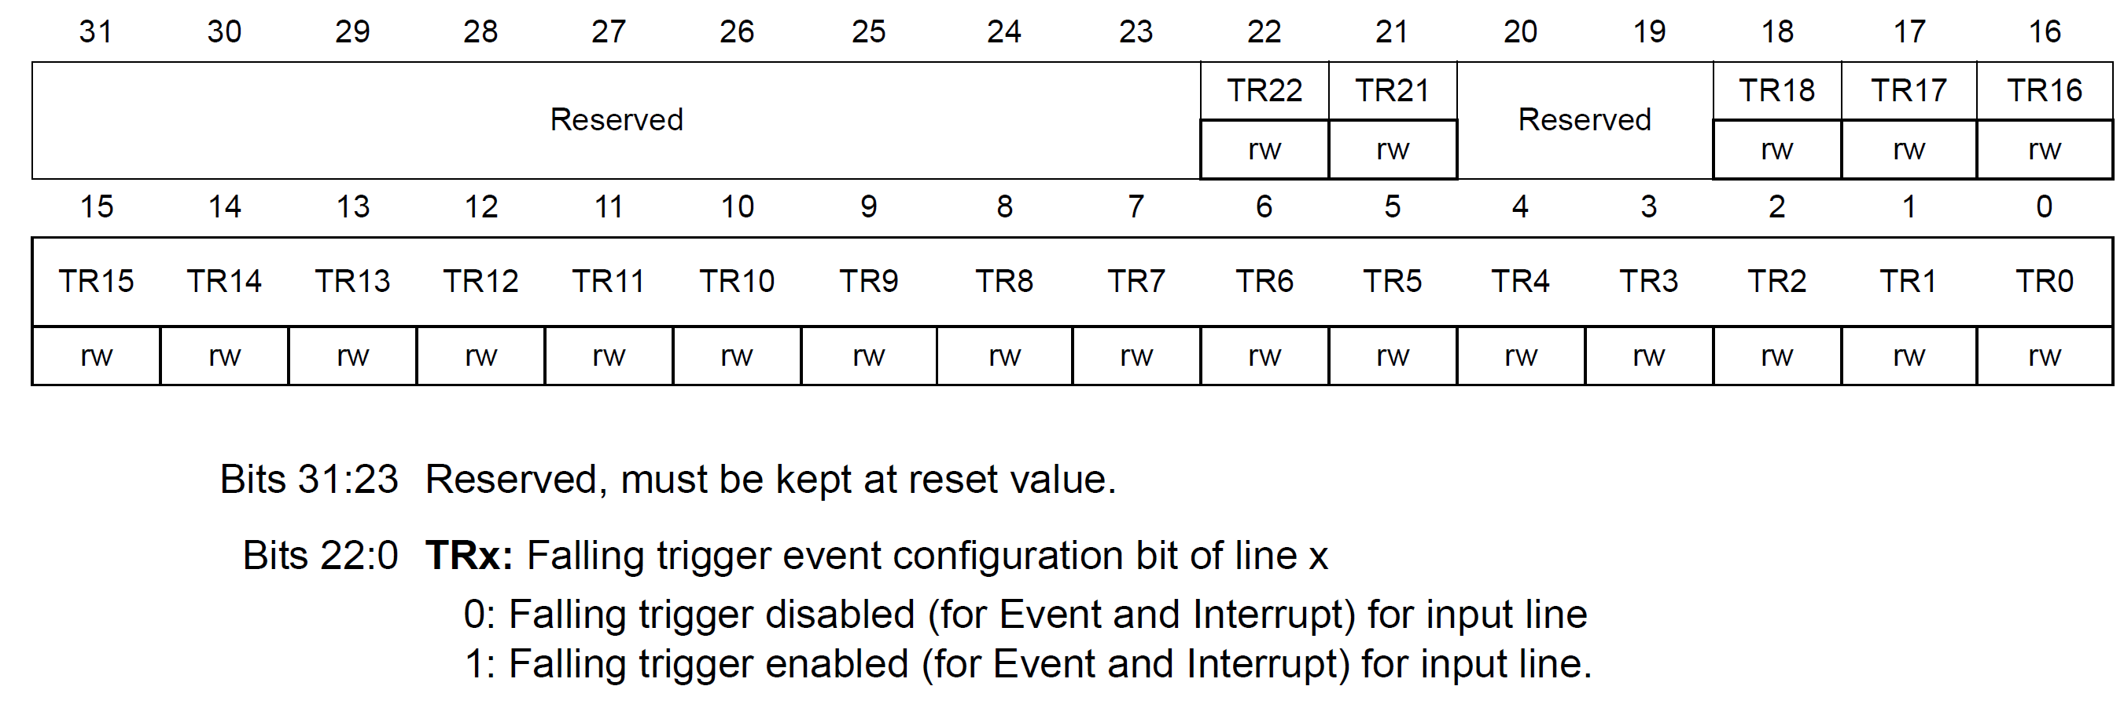
Select The Interrupt Trigger (2)
Falling trigger selection register (EXTI_FTSR)

Slide 14
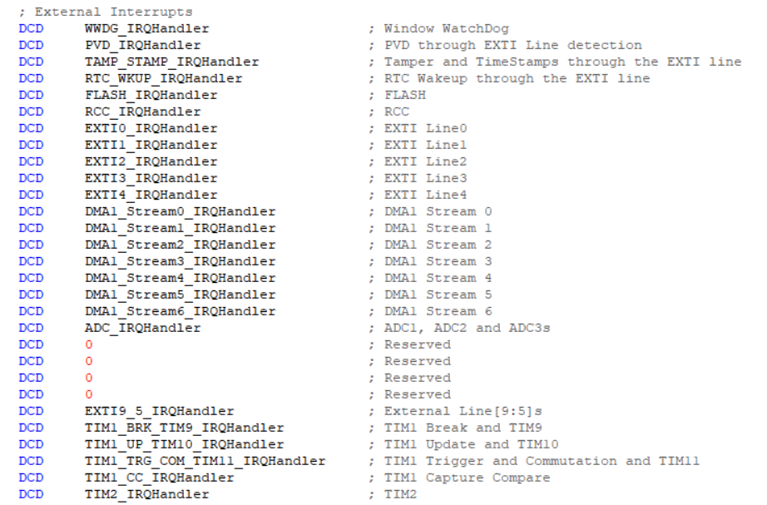
Enable NVIC

Slide 15
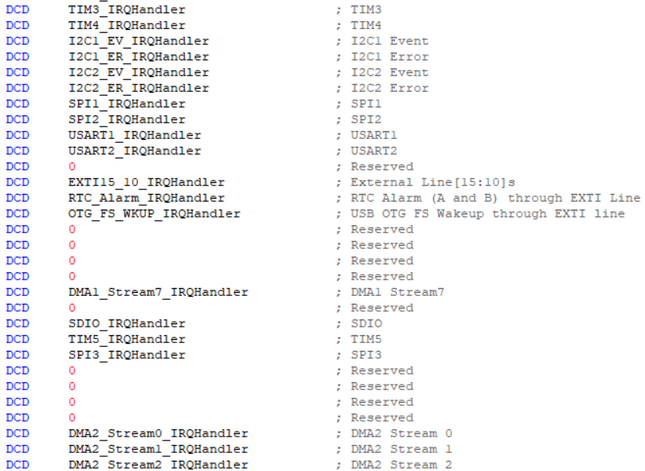
Enable NVIC

Slide 16
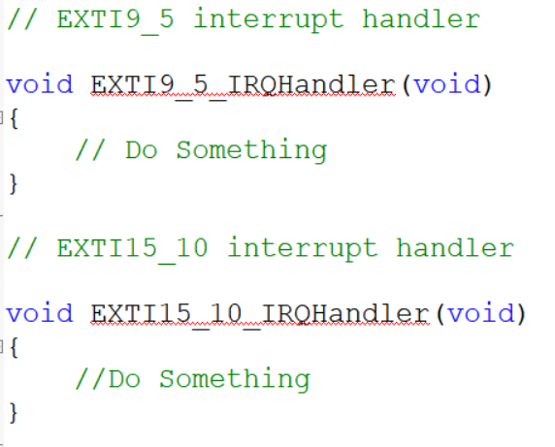
Enable NVIC

Slide 17
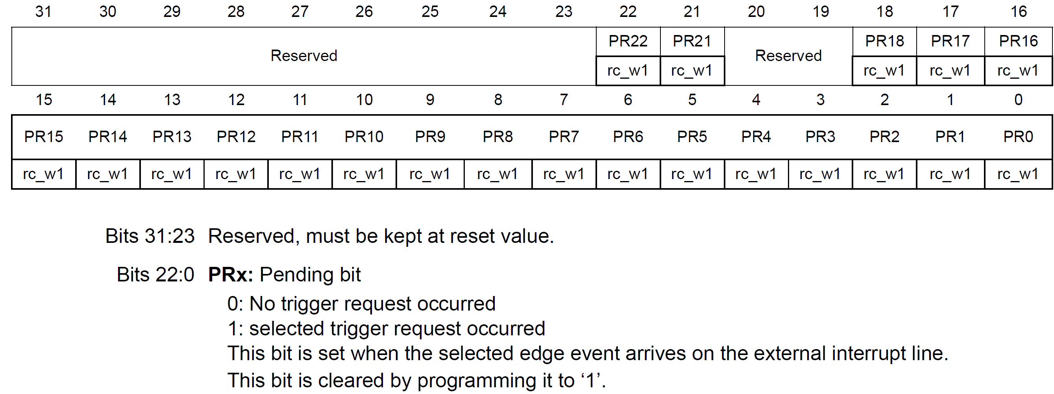
Pending register (EXTI_PR)

Slide 18
Experiment- Interrupt Demonstration
PA6 & PB10 as external interrupt source
PC14 as output

Slide 19
Thank You

